Slide 1
Chia VDF
Wesolowski Verifiable Delay Function Implementation

Slide 2
1
Recapitulando
En qué quedamos la última vez

Slide 3
Wesolowski VDF
Trapdoor VDF
Over 2 Groups:
RSA Group (→ Trusted Setup ☹ )
Imaginary Quadratic Fields (→ What? )

Slide 4
VDF Proposals
Wesoloswki
Pietrzak
De Feo
01
02
Trusted Setup over RSA Group. No need of trusted setup over IQF.
Trusted Setup over RSA Group
03
Trusted Setup over Isogenies and Pairings

Slide 5
2
Binary Quadratic Forms

Slide 6
“The theory of class groups of quadratic number fields can equivalently be presented in the language of binary quadratic form.”
—Benjamin Wesolowski

Slide 7
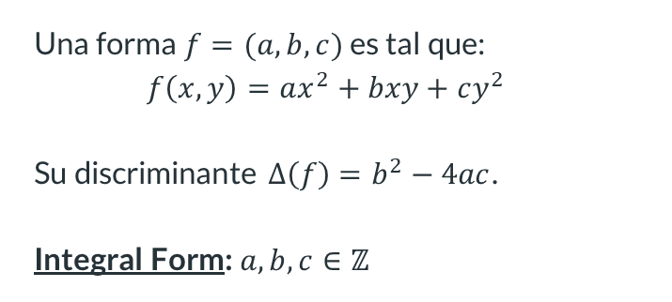
Binary Quadratic Forms
Una forma $f=(a,b,c)$ es tal que:
$$f\left(x,y\right)=ax^{2}+bxy+cy^{2}$$
Su discriminante $Δ\left(f\right)=b^{2}−4ac$.
Integral Form: $a,b,c∈ℤ$

Slide 8

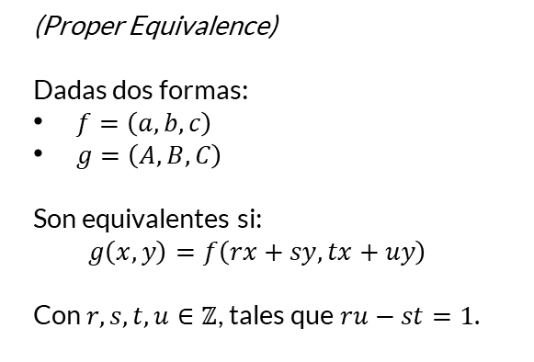
Equivalence
(Proper Equivalence)
Dadas dos formas:
$f=\left(a,b,c\right)$
$g=\left(A,B,C\right)$
Son equivalentes si:
$$g\left(x,y\right)=f\left(rx+sy,tx+uy\right)$$
Con $r,s,t,u∈ℤ$, tales que $ru−st=1$.

Slide 9
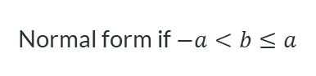
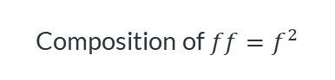
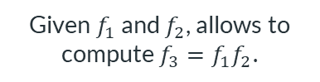
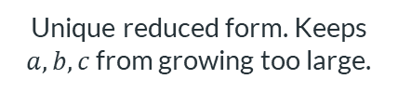
Operations
Normalization
Reduction
Composition
Squaring
Normal form if $−a<b≤a$
Unique reduced form. Keeps $a, b, c$ from growing too large.
Given $f_{1}$ and $f_{2}$, allows to compute $f_{3}=f_{1}f_{2}$.
Composition of $ff=f^{2}$

Slide 10
3
Procedure
Lo anterior aplicado a VDF

Slide 11

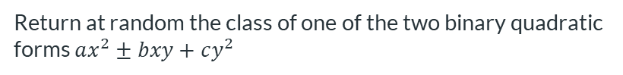
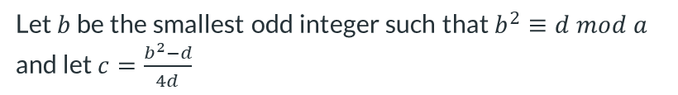

One could proceed as follows
01
From the hash input, use a cryptographic hash function to derive a random-looking odd prime number $a$
02
$d$ is a (nonzero) quadratic residue modulo $a$.
03
Let $b$ be the smallest odd integer such that $b^{2}≡d mod a$ and let $c=\frac{b^{2}−d}{4d}$
04
Return at random the class of one of the two binary quadratic forms $ax^{2}±bxy+cy^{2}$

Slide 12
4
Algorithms

Slide 13
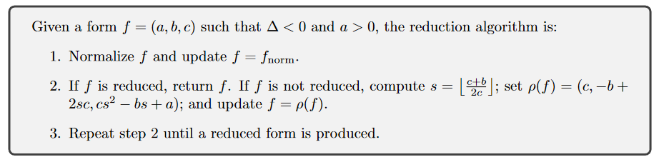
Reduction

Slide 14
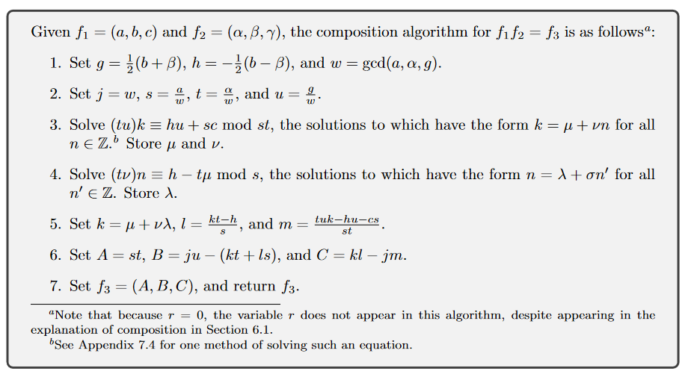
Composition

Slide 15
Thanks
Please keep this slide for attribution

